Slide 1


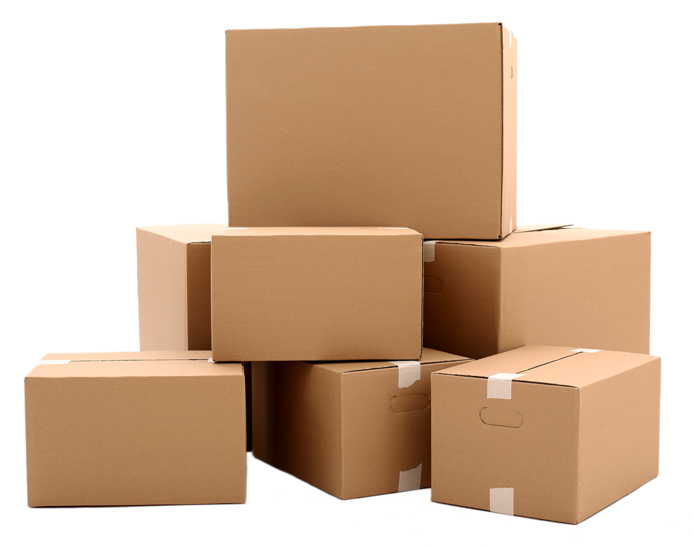


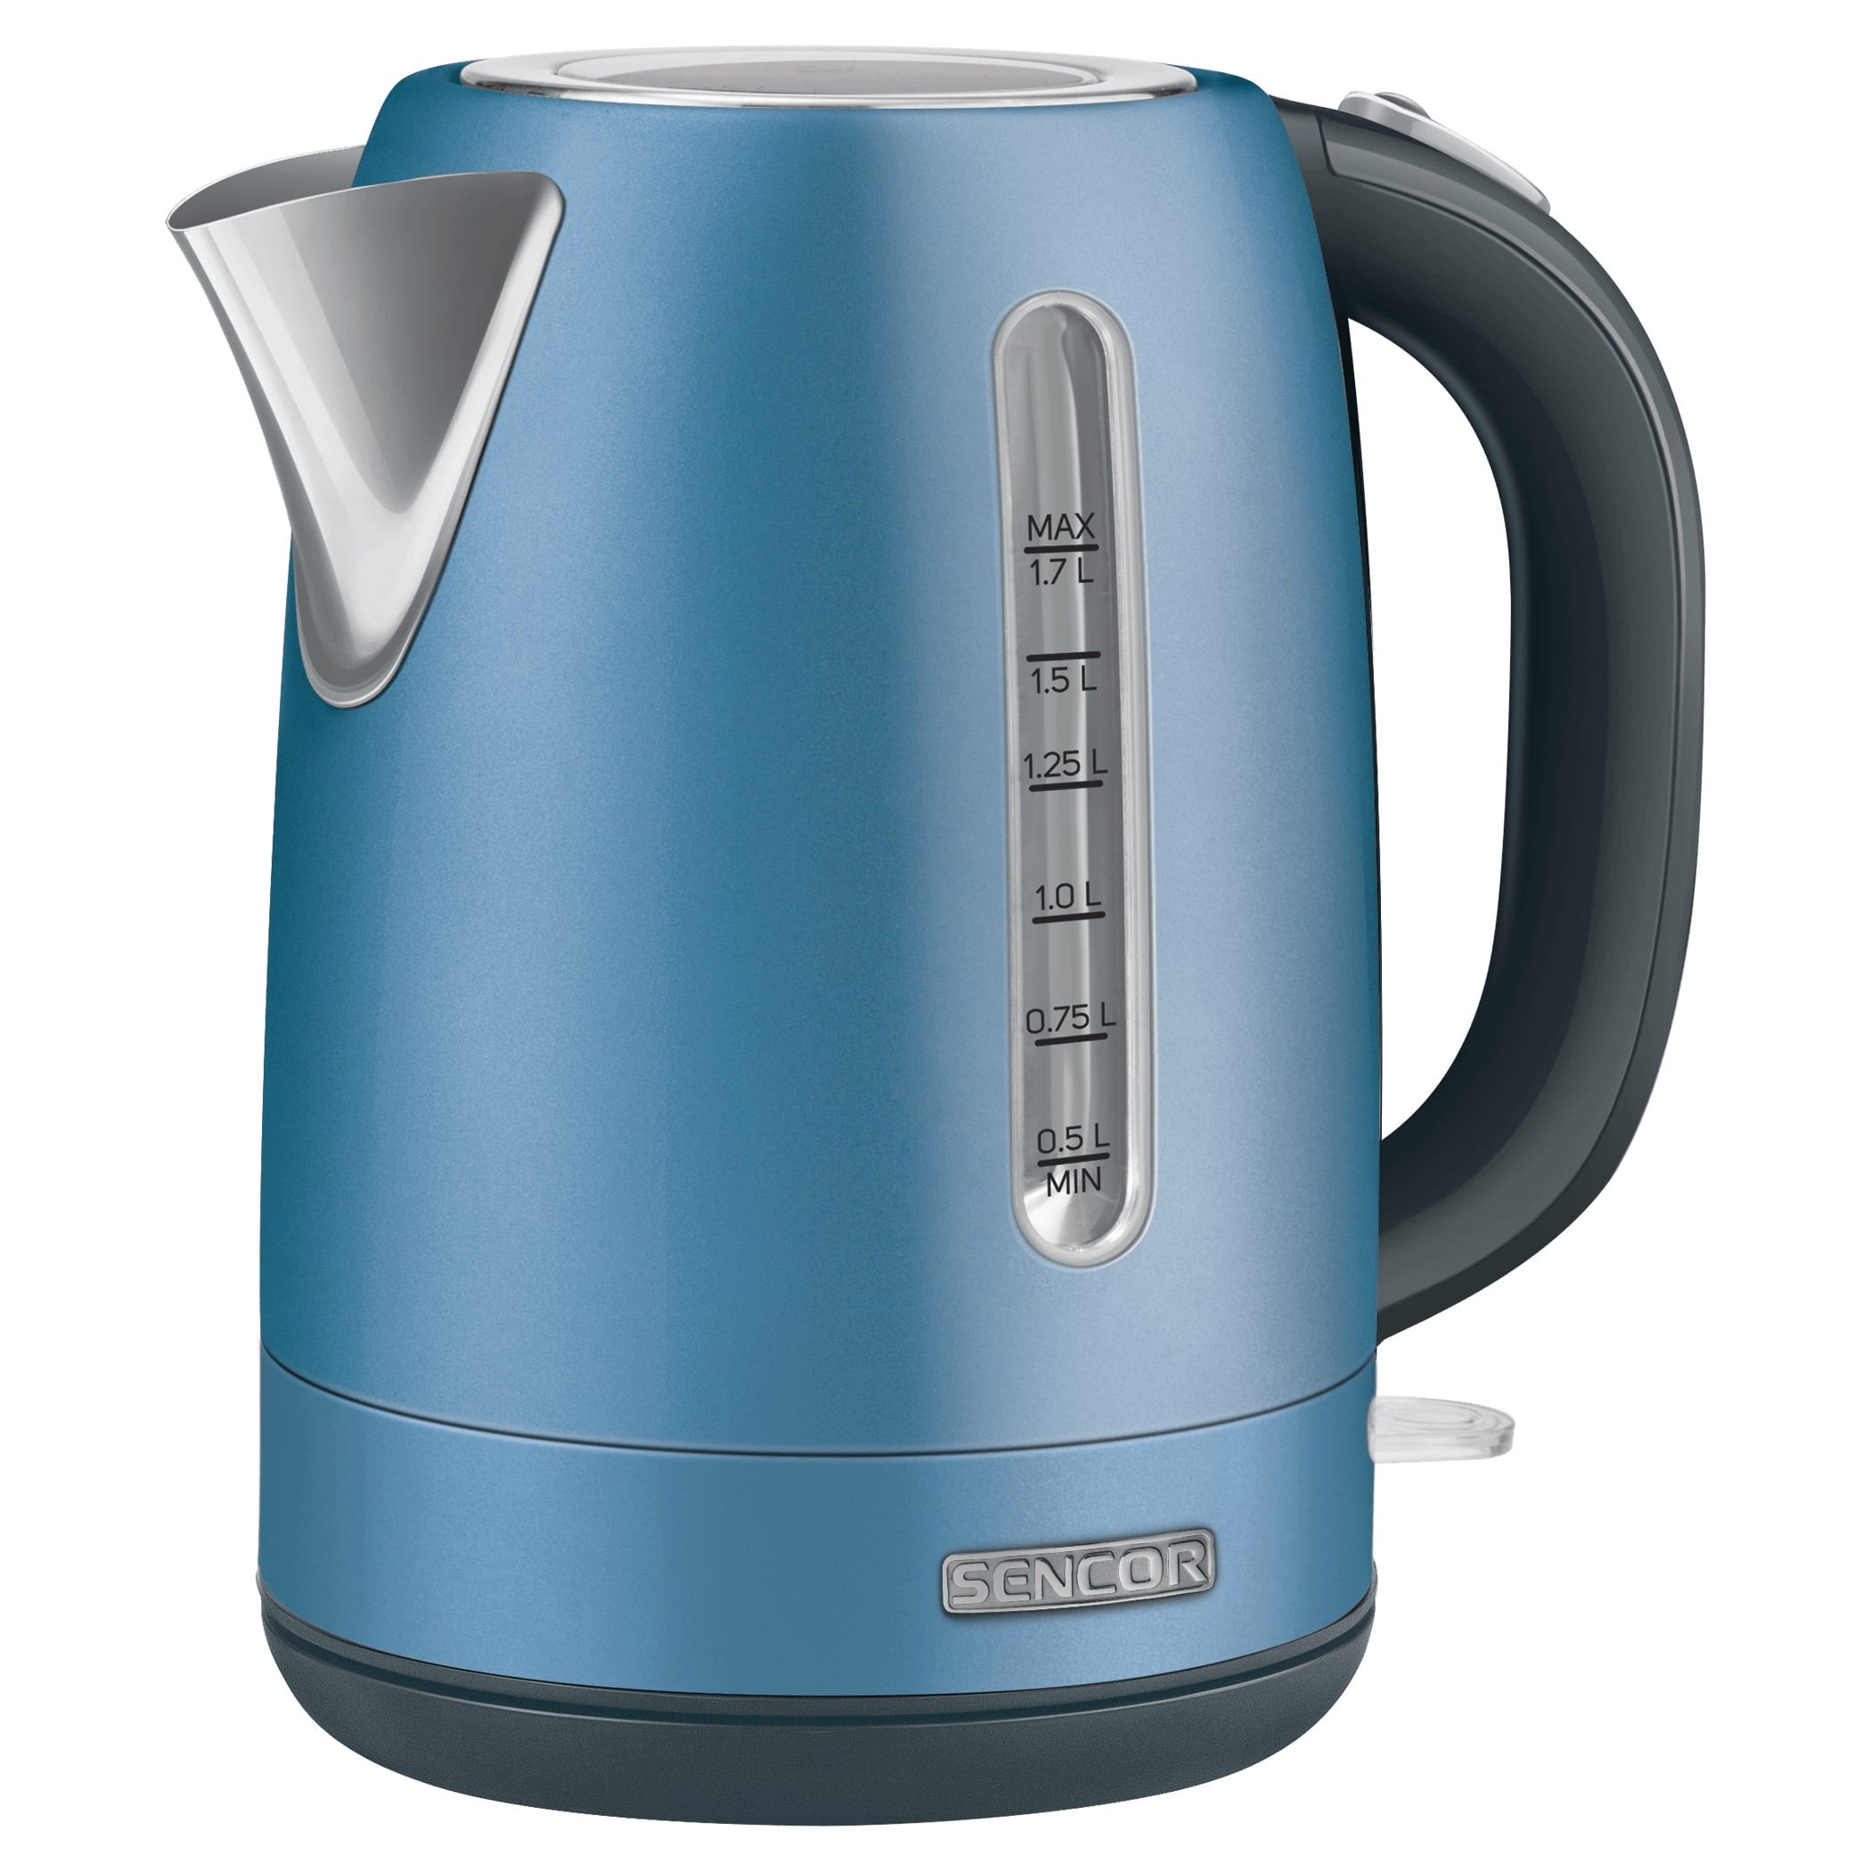
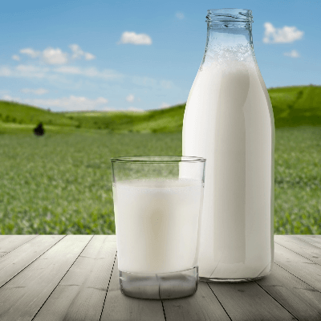
Life Cycle Assessment (LCA): From Farm to Cup
Functional unit: One 250 ml cup, black coffee (no milk).
System boundary: Farm inputs, processing, transport, roasting, packaging, retail, consumer brewing, end-of-life.
Black cup: ≈0.21 kg CO2e
With 30ml milk: ≈0.34 kg CO2e
Latte 200ml milk: ≈0.9 kg CO2e
Stage: Farm/inputs/land mgmt, Share: 45%
Stage: Roasting, Share: 6%
Stage: Packaging, Share: 6%
Stage: Transport (origin→market), Share: 5%
Stage: Retail/last-mile, Share: 3%
Stage: Consumer brewing energy, Share: 35%
Water footprint note: Large green water (rain) component; blue water hotspots in irrigated regions (e.g., Brazil, Vietnam).
Notes: Indicative factors; actuals vary by farming practice, energy mix, brewing method, and serving size.

